Slide 1

PureSense
Team 1
A Smart Solution for Cleaner, Safer Air
Ahmed Gaber / M11207824 Kathi / E11309005 Lina Wang /D11251001 Salma / M11202814 Zephaniah Irwan / M11251801

Slide 2
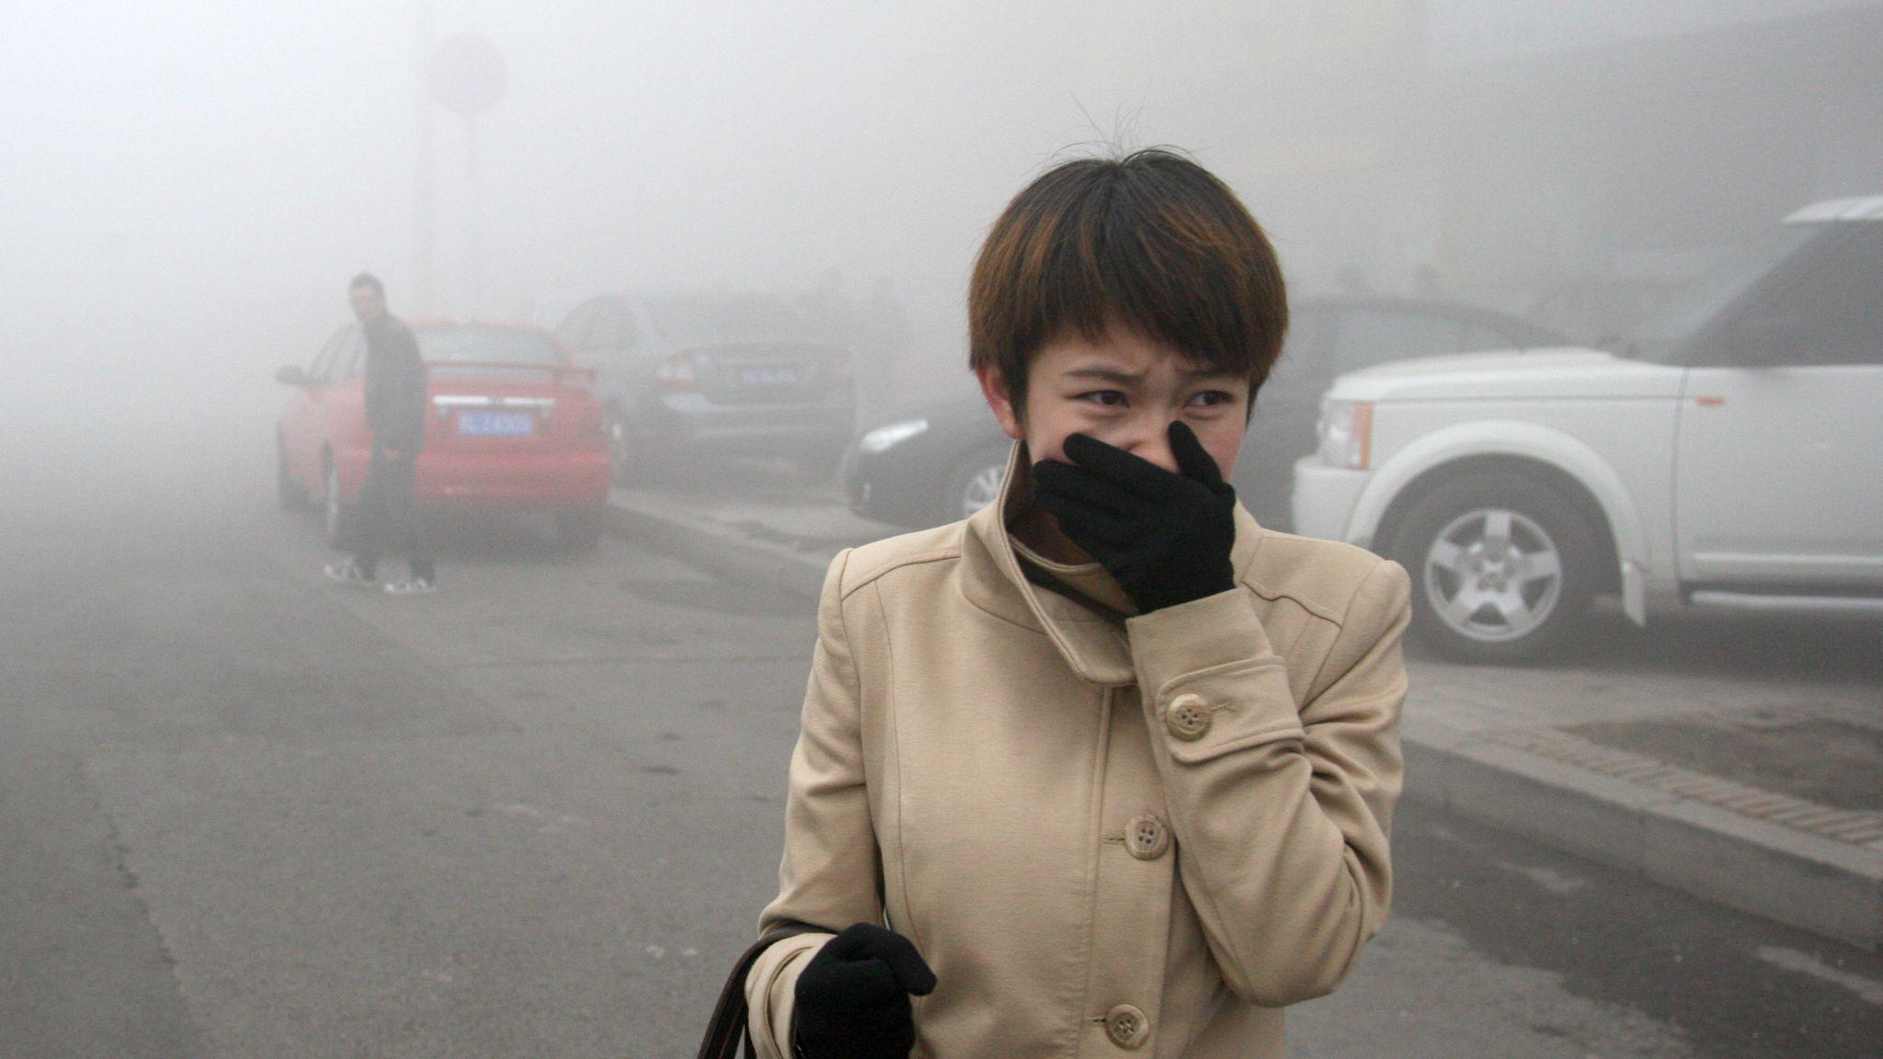
Introduction

Slide 3
The problem
Definition
Source of Pollution
Air pollution is a mix of hazardous substances from both human-made and natural sources. These substances, known as pollutants, can be solid particles, liquid droplets, or gases.
lignite coal
industrial processes
open burning of waste
motor vehicles and transportation
Dust storms
Volcanic Eruption
Secondhand Smoke

Slide 4
The problem
6.5 Million
Deaths
/ Year
WHO Data
UNICEF Data on Children
709,000 deaths in children under 5 years old
2024 State of Global Air
2,000 children under 5 die

Slide 5
Children Vulnerability
Physically
Physiologically
Young children breathe more rapidly than adults and take in more air relative to their body weight
They often spend more time outdoors and breathe air that is closer to the ground, which puts them in closer proximity to sources of pollution like dust and vehicle exhaust.
Children also spend a significant amount of time indoors, and so may be significantly affected by household air pollution.
Children are physiologically more vulnerable to air pollution than adults because their brains, lungs and other organs are still developing.
Some air pollutants can cross the placenta and affect developing babies. Air pollution can also affect lung function and development, which continues through adolescence.

Slide 6
Parameter
CO2 (Carbon Dioxide)
Standard: Maximum allowable concentration of 1000 ppm.
Effects of High CO2: Elevated CO2 levels can cause drowsiness, headaches, and impaired concentration. Prolonged exposure in poorly ventilated areas can lead to discomfort and reduced productivity.
Humidity
Recommended Range: Between 40% and 70% relative humidity.
Effects of Improper Humidity: Too low humidity can lead to dryness of the skin and respiratory system, while too high hu64midity fosters mold growth, increasing the risk of allergic reactions and respiratory issues.
Temperature:
While there are no strict temperature limits, maintaining a comfortable indoor temperature, typically between 18°C and 28°C, is advised to ensure a healthy environment and reduce the risk of excessive heating or cooling affecting air quality.
Effect : Lower than 18°C can lead to discomfort, cold stress, and respiratory issues, while temperatures above 28°C can increase the risk of heat-related illnesses and reduce cognitive performance.
Volatile Organic Compounds (VOCs)
Standard: The total concentration of VOCs should remain below 0.56 mg/m³.
Effects of High VOCs: VOCs include chemicals like benzene, toluene, and formaldehyde, which can lead to short-term effects such as eye and respiratory irritation, and long-term exposure is linked to more severe health issues, including cancer.
PM10 (Particulate Matter, ≤10 micrometers)
Standard: Maximum allowable concentration of 75 µg/m³.
Effects of High PM10: Inhalation of coarse particulate matter can cause respiratory irritation, coughing, and aggravate conditions like asthma. PM10 primarily affects the upper respiratory system.

Slide 7
Proposed Solution
PureSense is a compact, advanced device designed to provide users with a comprehensive understanding of air quality in their immediate environment. By detecting multiple parameters—including carbon dioxide (CO₂), particulate matter (PM), volatile organic compounds (VOCs), humidity, and temperature—PureSense delivers an in-depth picture of indoor air quality.
It allows users to assess and respond to air pollution risks in real-time, taking action to protect their health and well-being. Unlike simpler devices that focus on one or two pollutants, PureSense empowers users with precise, actionable insights into a broad spectrum of air contaminants and environmental factors, helping them to maintain a cleaner, safer, and healthier living space.

Slide 8

Hardware

Slide 9
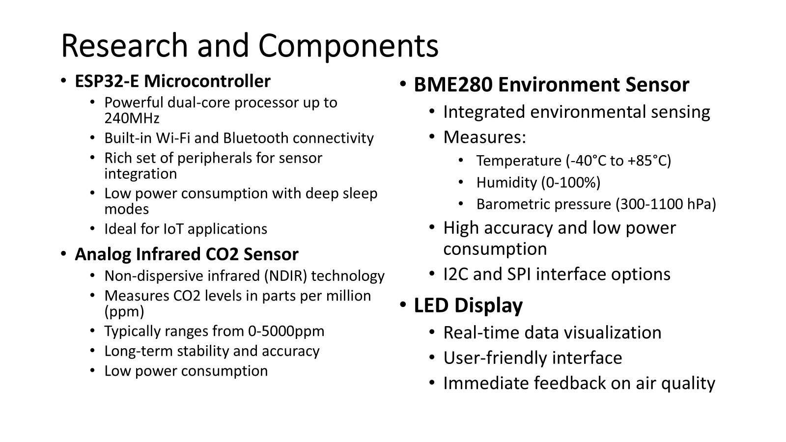

Slide 10
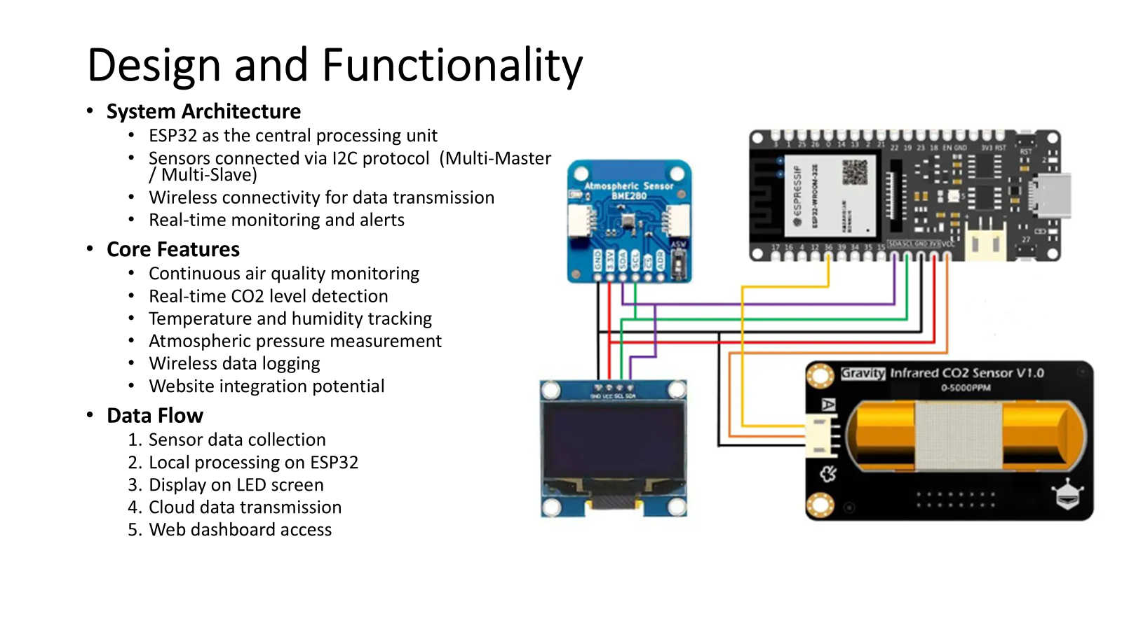

Slide 11
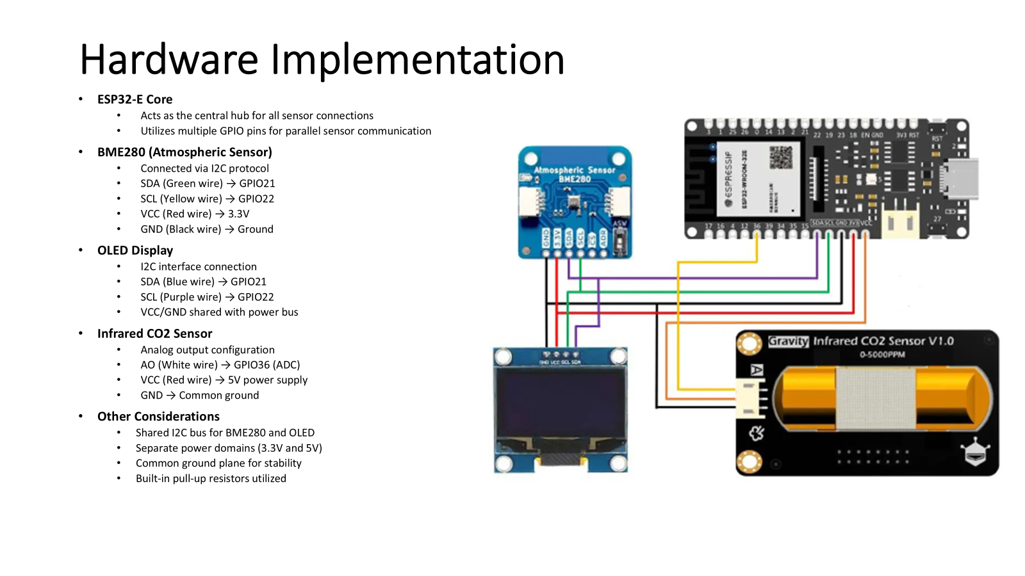

Slide 12

Software

Slide 13


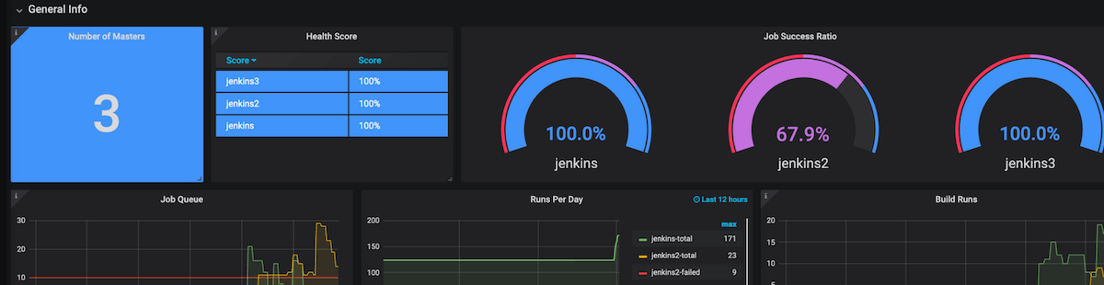
Programming in Arduino
Take sensor readings (CO2, particulate matter, temperature, humidity) every minute.
Update readings on the OLED display.
Use Prometheus and Grafana for storage and analysis.
Notes:
The software development process involved programming the Arduino microcontroller to gather data from each sensor, process it, and display the results on OLED. Challenges included calibrating the sensors and ensuring the data was accurate. Through testing, the code will be optimized for consistent readings.
Prometheus and Grafana are popular tools often used together for storing, monitoring and visualizing data from IoT systems, servers, and other infrastructure.

Slide 14

Prometheus Integration and WiFi Configuration
Prometheus Integration:
Configure Prometheus to collect air quality data from the device.
Set up Prometheus as a remote data storage solution for real-time and historical data analysis.
WiFi Configuration Setup:
Define WiFi network details (SSID and password).
Add Grafana Cloud’s Remote Write Endpoint, Username, and API Key.
Ensure a stable WiFi connection for consistent data posting to Prometheus.
Data Transmission:
Configure the Arduino sketch to post sensor data to Prometheus every minute.
Monitor successful data transfers to Prometheus and troubleshoot any connectivity issues.
Notes:
Prometheus is an open-source monitoring and alerting toolkit.
Functionality:
Primarily used to collect and store time-series data (over intervals of time).
Stores data locally and can trigger alerts based on pre-defined conditions (thresholds values) (e.g., high CO2 levels).
Why It’s Used in IoT Projects:
Ideal for monitoring sensor data and environmental metrics.
Provides efficient data storage and can handle large amounts of time-series data.
For example: in this indoor air quality monitor project, Prometheus would collect sensor data (like CO2 levels, temperature, etc.) from the Arduino

Slide 15

Grafana Dashboard Design and Visualization
Setting Up Grafana:
Create a custom Grafana dashboard linked to Prometheus data.
Add widgets to visualize sensor data, including instantaneous and historical Grafana Dashboard Design and Visualization
Dashboard Components:
Instantaneous Gauges: Real-time display for CO2, temperature, and humidity.
Time-Based Trends: Visualize changes over time for each metric to track air quality patterns.
Customization and Alerts:
Customize the dashboard layout for clarity and usability.
Set alerts in Grafana for thresholds (e.g., high CO2 levels) to notify users of poor air quality.
Notes:
Grafana is an open-source visualization and analytics platform.
It allows users to create, explore, and share dashboards that visualize data in real-time.
Functionality:
Connects to various data sources, including Prometheus, to visualize and monitor time-series data.
Users can create custom dashboards with gauges, graphs, and tables to display sensor data or other metrics.
Supports setting up alerts, so users receive notifications when certain thresholds are exceeded.
Why It’s Useful for IoT:
Grafana makes data easy to understand by transforming raw numbers into visual charts and graphs.
Perfect for creating a centralized dashboard that displays real-time IoT data for analysis and decision-making.

Slide 16
Testing and Troubleshooting
Comprehensive Testing Process:
Test in various indoor environments (e.g., classrooms, labs, homes) to assess performance.
Document sensor accuracy and data transmission reliability in each setting.
Troubleshooting Common Issues:
WiFi Connectivity: Ensure stable connections; troubleshoot by checking network strength and re-configuring settings as needed.
Sensor Accuracy: Regularly calibrate sensors to maintain data accuracy.
Data Display: Adjust display intervals and troubleshoot OLED refresh issues if data isn’t updating smoothly.
Final Verification:
Confirm data consistency across the OLED display, serial monitor, Prometheus, and Grafana.
Ensure alerts in Grafana are triggered correctly and dashboards display accurate, real-time data.
Notes:
To ensure accuracy, we conducted several rounds of testing in different indoor settings. Calibration was essential for each sensor to make sure the data was reliable. These tests confirmed that the device consistently produces accurate readings in various environments.

Slide 17
Marketing

Slide 18
Product positioning & pricing strategy
Value propositions:
Supply chain management
Key partnerships
Marketing strategy:
Comprehensive detecting ~~
OEM
Components suppliers
Logistics center
Website Maintenance center
E-commerce platform
Channels ~~
Define target
Product attributes
Identify competitors
Pricing strategy
CO₂
VOCs
Temperature
PM
Suppliers
Exhibition
E-commerce
Direct sales
PR activities
Manufacture
II
V
Purchasing management:
Distribution
Customer segments
Needs
Purchase
Inspection
Evaluation
Suppliers
Workflow
Invoice
Hospital
Nursing home
Internet celebrities/YouTubers
Distributors
Customers
I
III
IV
VI
VII
Customer relationships & after service
Revenue streams
Customer service center
Technical service center
Promotion events
1. Link to sales strategies & marketing plan.
2. Revenue growth concern with innovation in products and business model as well.
VIII
IX
Framework defining the supply chain business processes
Scope: Plan, Source, Make, Deliver, and Return
Manufacturer
Manufacturing Value-Added Transformation Processes
Plan
Suppliers
Customers
Source
Make
Deliver
Source: http://www.supply-chain.org/cs/root/home

Slide 19
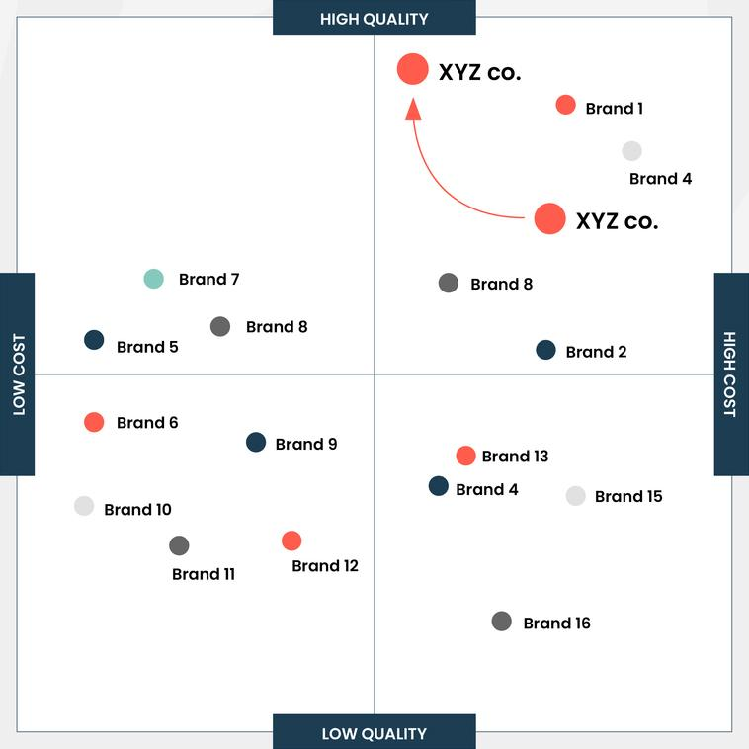
I. Product positioning & pricing strategy
1. Define target market and personas.
2. Select our product attributes to compare.
3. Identify existing products in the market.
4. Plot key competitors on the map.
5. Create and execute our pricing strategy.
Source: https://www.productmarketingalliance.com/what-is-a-perceptual-product-positioning-map/

Slide 20






II. Value propositions:
Monitor indoor air quality about ..
Comprehensive detecting carbon dioxide (CO₂), particulate matter (PM), volatile organic compounds (VOCs), humidity, and temperature.

Slide 21
III. Purchasing management:
Key Stages of the purchasing process
1
Identifying needs.
2
Supplier research and request for proposal (RFP).
3
Purchase requisition and approval workflow.
4
Purchase order creation and issuance.
5
Receiving and inspection.
6
Invoice approval and payment.
7
Review and supplier performance evaluation.

Slide 22














IV. Supply chain management:
Suppliers
Manufacturers
Warehouses and distribution centers
Customers
Transportation costs
Transportation costs
Material costs
Manufacturing costs
Inventory costs

Slide 23


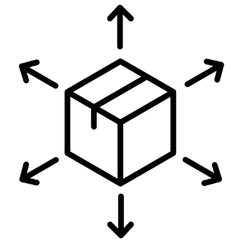


V. Key partnerships:
OEM
Components suppliers
Logistics center
Website Maintenance Center
E-commerce platform

Slide 24


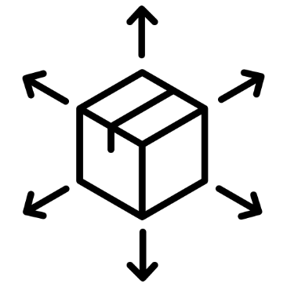

VI. Customer segments:
Hospital
Nursing home
Internet celebrities
YouTubers
Distributors

Slide 25




VII. Marketing strategy:
Channels ~~
Exhibition
E-commerce
Direct sales
PR activities

Slide 26



VIII. Customer relationships & after service:
Customer service center
Technical service center
Promotion events

Slide 27





IX. Revenue streams:
1. Link to sales strategies & marketing plan.
2. Revenue growth concern with innovation in products and business model as well.
TAX PLANNING
FINANCIAL INDEPENDENCE
CASH FLOW
INVESMENT PORTOFOLIO
CASH MANAGEMENT

Slide 28
Website &
Documentation

Slide 29

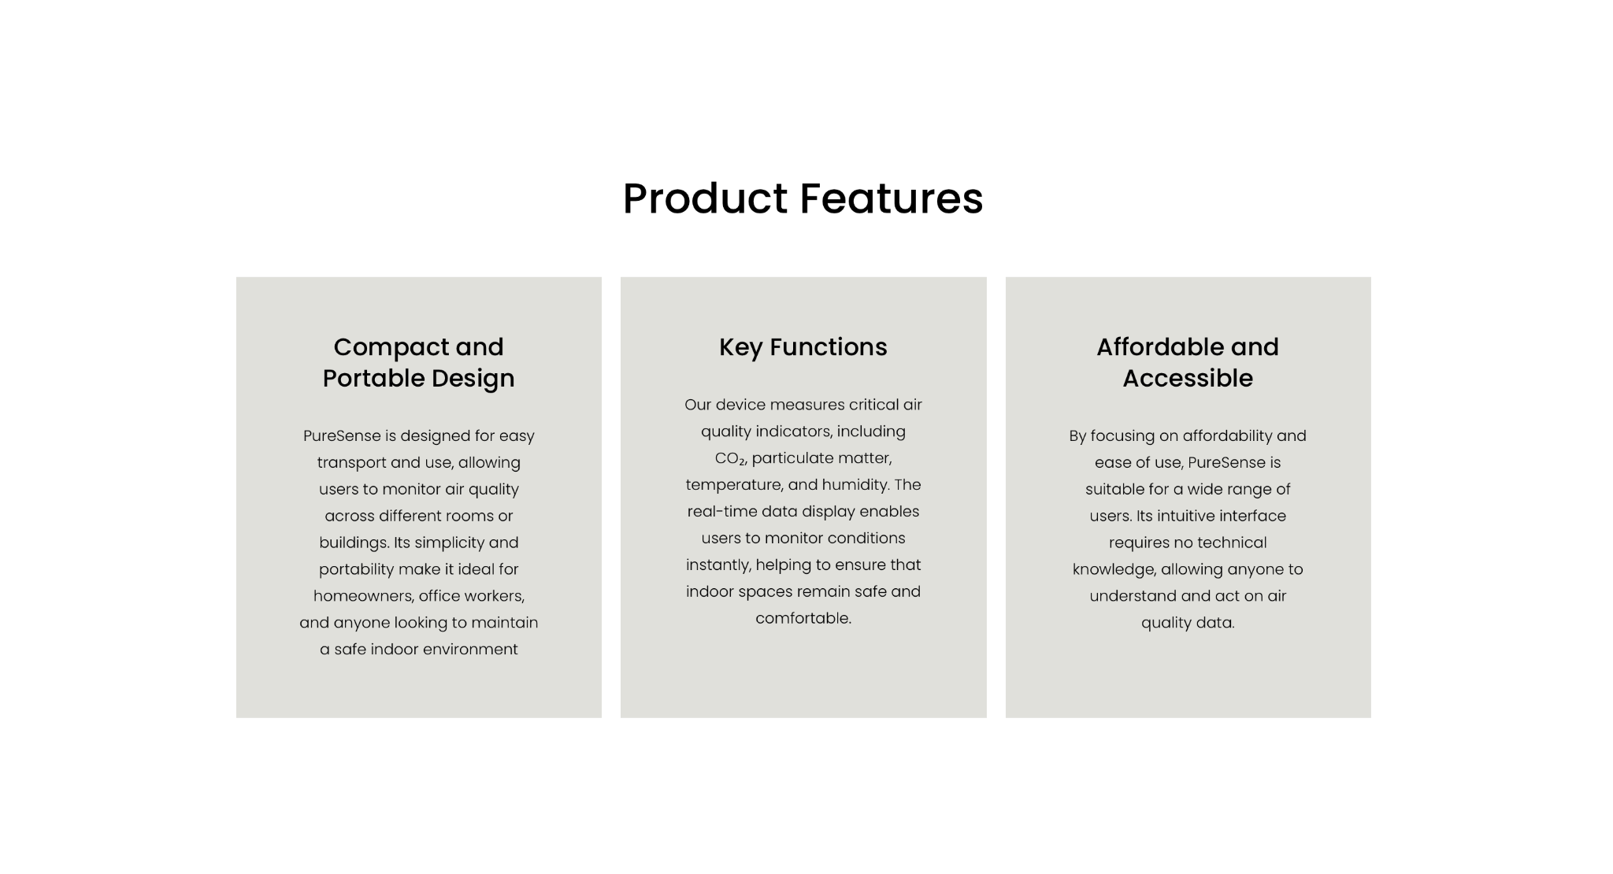



Website Overview
Currently our website includes the following pages:
Home Page
Provides an introduction to our product
Highlights Key Product Features
Explains important air quality parameters
About Page
Introduces our team and core functions
Contact Page
Gives the opportunity to contact us
Since the website is currently under construction, it is saved with a password: iiotgroup1
Notes:
To ensure accuracy, we conducted several rounds of testing in different indoor settings. Calibration was essential for each sensor to make sure the data was reliable. These tests confirmed that the device consistently produces accurate readings in various environments.

Slide 30
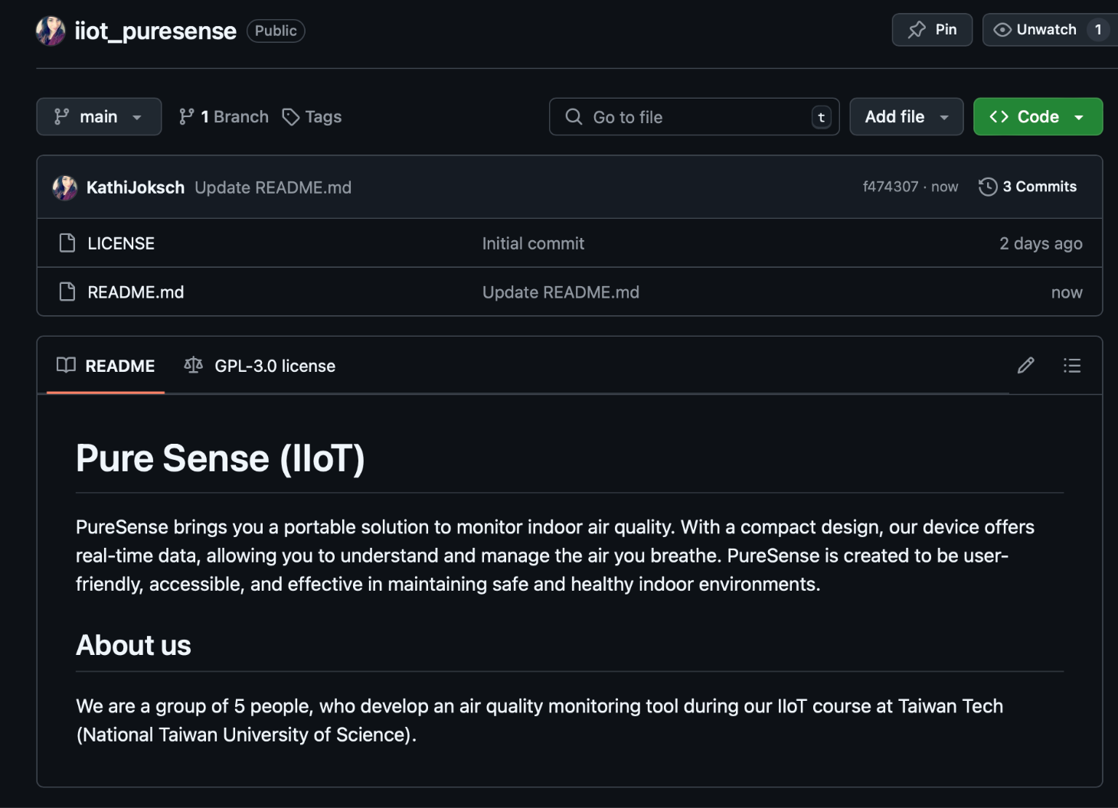
Our Documentation on GitHub
In the future, we will maintain our software & hardware setup on GitHub, where we’ll also provide regular updates. This allows easy access to our latest developments and ensures transparency as we continue to improve our project.
https://github.com/KathiJoksch/iiot_puresense

Slide 31
Thank you

